Slide 1
Cauliflower Mosaic Virus
KAVITA BASUMATARY
ASSISTANT PROFESSOR
DEPARTMENT OF BOTANY
GOALPARA COLLEGE

Slide 2
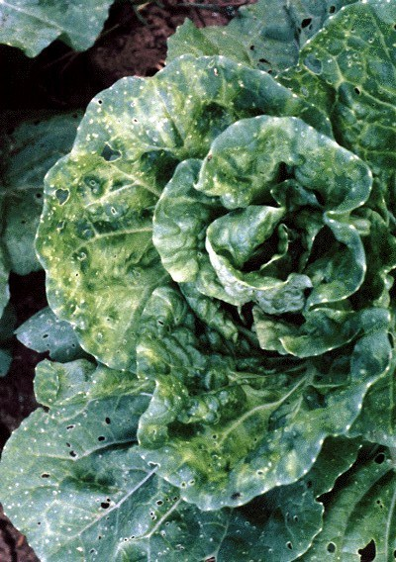
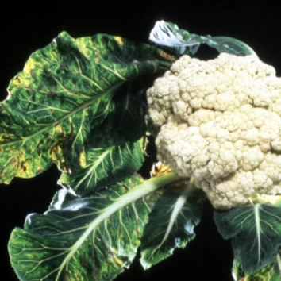

Slide 3
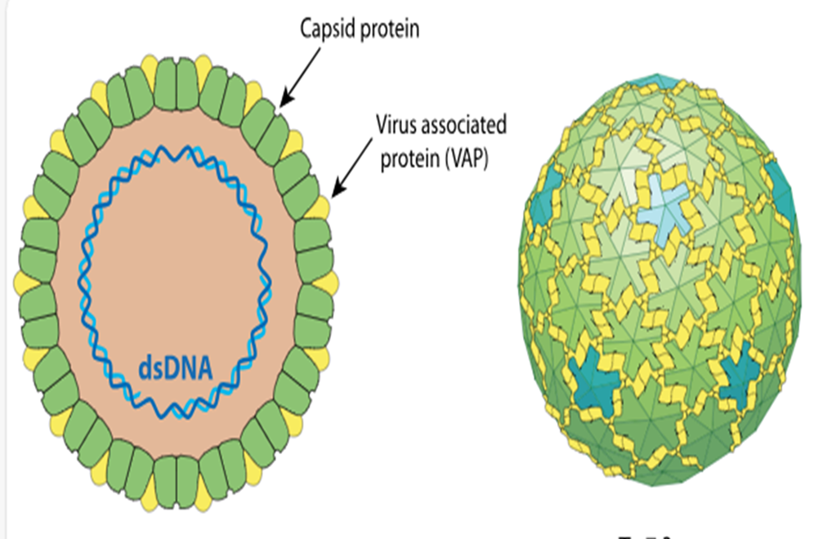
Structure of Virus:

Slide 4
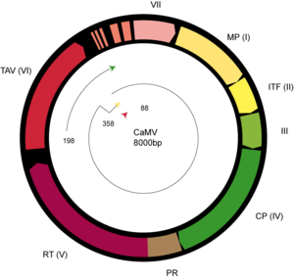
Structure of Viral Genome:
The CaMV genome consists of circular, double-stranded DNA approximately 8000 bp in length.
The genome contains three discontinuities typical of pararetroviruses.
There are seven open reading frames (ORFs) which code for six proteins of known function; P1-P6.
Two main RNAs are produced from cccDNA: pregenomic 35S RNA and subgenomic 19S RNA.

Slide 5
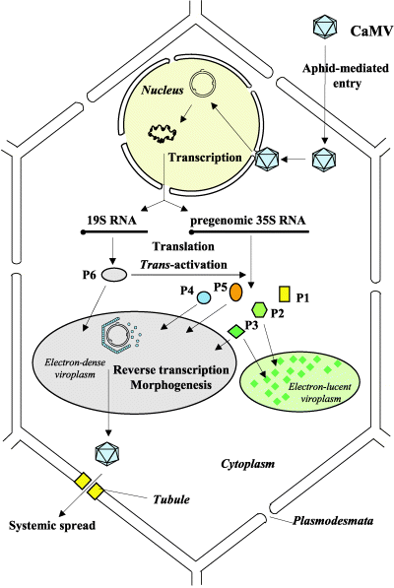
Reproduction of Virus:
The virion enters the host cell, moves to the nuclear pore, and the viral genome is imported in the nucleus.
Discontinuities in the genomes are repaired to form minichromosomes.
Minichromosomes are used as templates to produce 35S RNA & 19S RNA.
P6 is translated from 19S RNA and accumulates in electron-dense inclusion bodies (edIBs)
P6 transactivates production of P1-P5 from 35S RNA
Packaging occurs.
The virion may either reinfect the nucleus to increase the copy number of the minichromosome (early in the infection) or it may leave the cell.

Slide 6
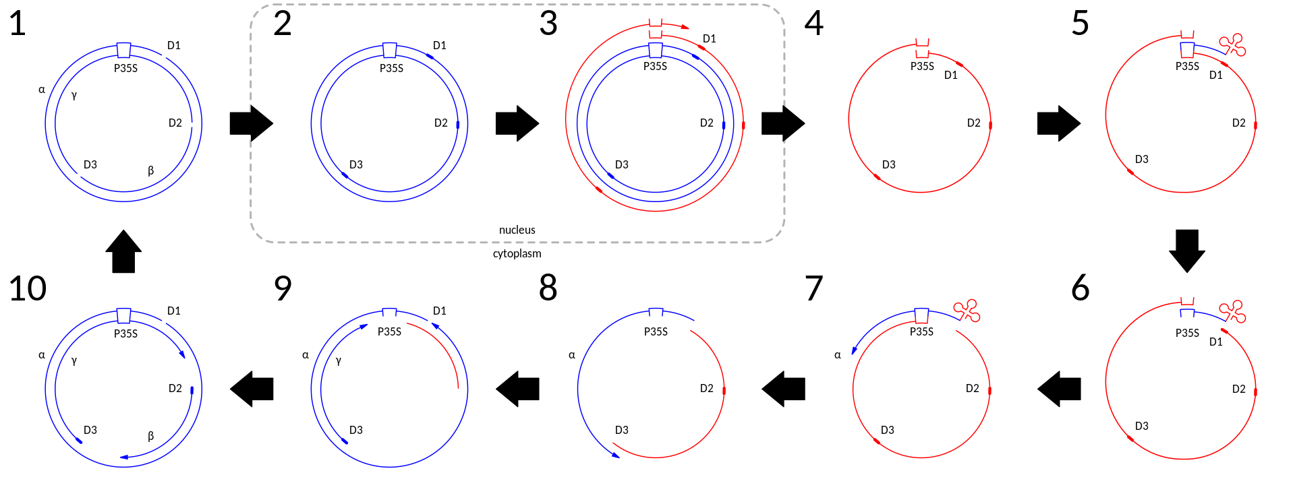
Replication of viral Genome:

