Slide 1
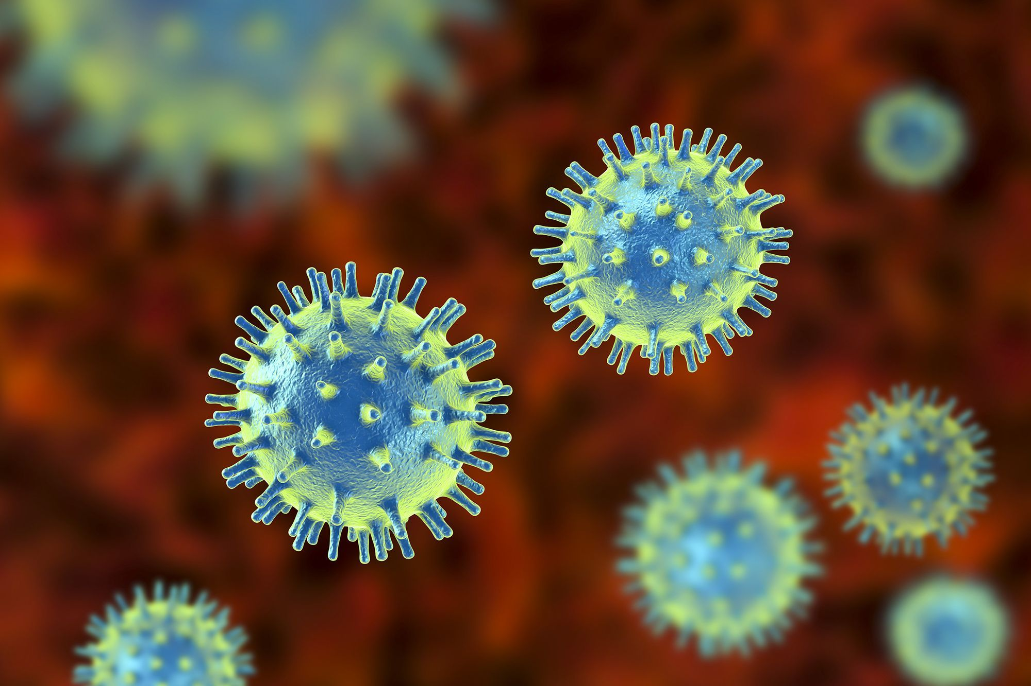

Slide 2
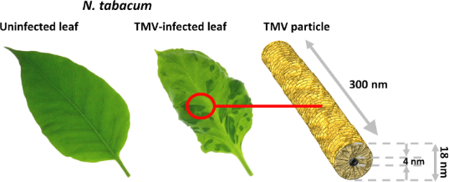

Slide 3
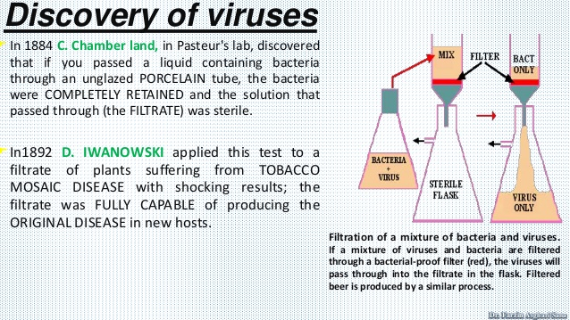

Slide 4
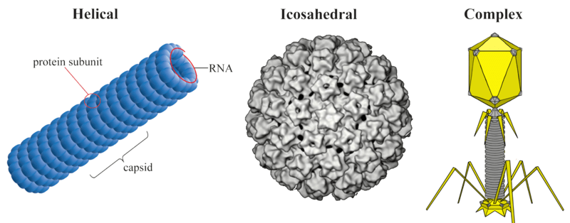
Shapes of viruses

Slide 5
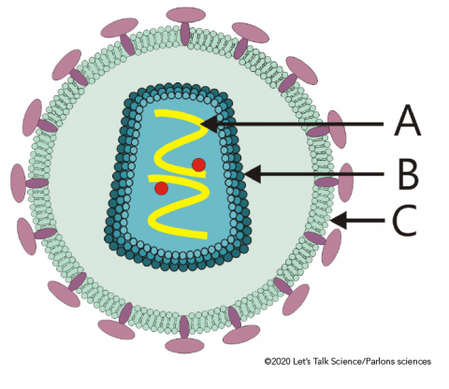

Slide 6
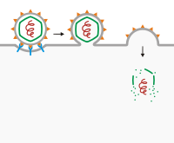

Slide 7
Physiochemical characters:
Nucleic Acids- DNA & RNA
Types of Nucleic Acids –
Virus with ssDNA
Virus with dsDNA
Virus with ssRNA
Virus with dsRNA
Virus with single stranded cyclic DNA
Virus with double stranded cyclic DNA
Virus with single stranded cyclic RNA
Virus with double stranded cyclic RNA

Slide 8
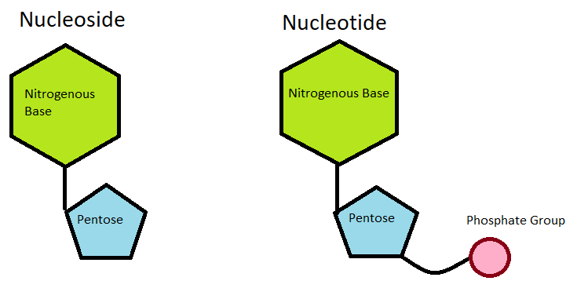
Primary Structure of Viral Nucleic acid

Slide 9
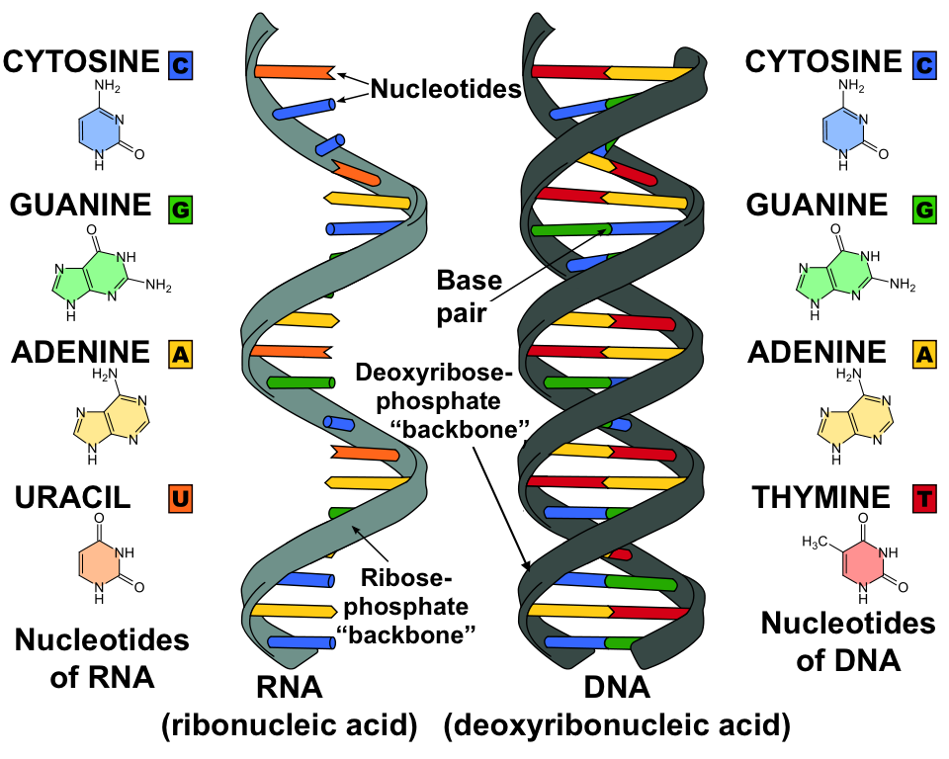

Slide 10
