Slide 1
UNIT 2
Shielding and Slater's Rule
By Hemanta Deka

Slide 2
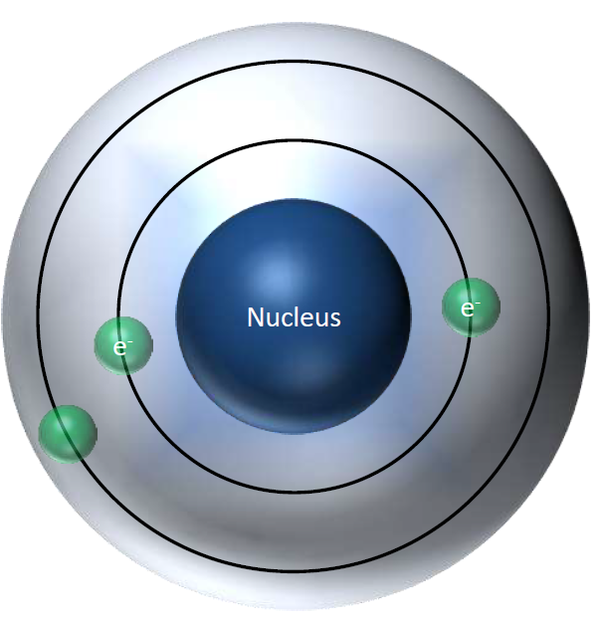
Average radius of 2s
orbital is greater
than 1s.
2s electrons are
repelled by 1s
electrons.

Slide 3
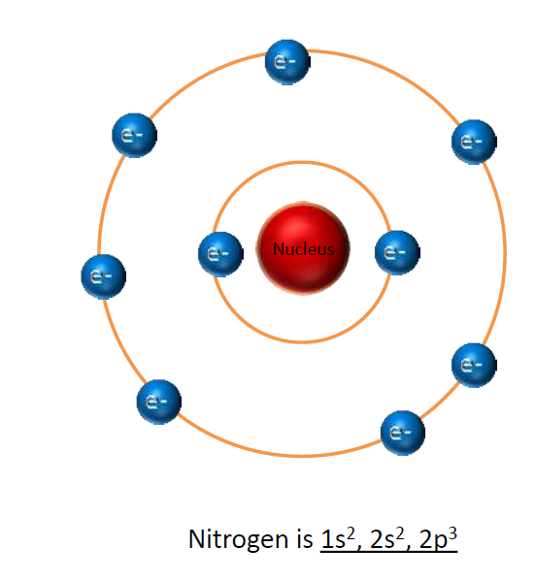
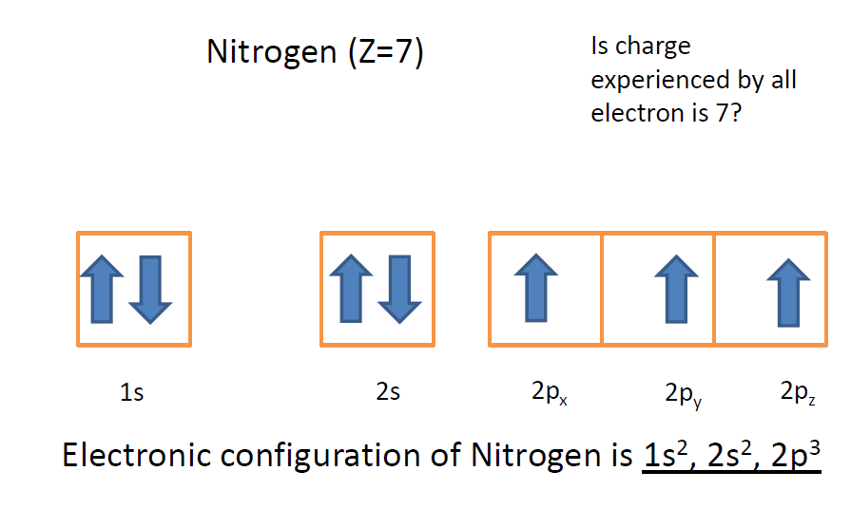
Z_{eff} (Effective Nuclear Charge)

Slide 4
Estimate the extent of shielding (σ):
Slater’s Rules
Step 1- Write the electron configuration of the atom in the following order:
(1s) (2s, 2p) (3s, 3p) (3d) (4s, 4p) (4d) (4f) (5s, 5p) …., etc
Step 2- Identify the electron of interest and ignore all electrons in higher (higher energy levels) groups as the electrons in higher energy levels will not contribute to shielding of lower energy group electrons.
Step 3- Slater's Rules are classified as follows
A) Shielding experienced by an s and p electrons.
All the electrons within same group shield 0.35.
All the electrons within the n-1 group shield 0.85
All the electrons within the n-2 or lower groups shield 1.00
B) Shielding experienced by nd and nf valence electrons
All the electrons within same group shield 0.35
All the electrons within the lower groups shield 1.00
Shielding constant can be calculated
Z_{eff} = Z-σ

Slide 5
Numerical
Calculate the Zeff on valance electron of Nitrogen.
Atomic number is 7.
Electronic configuration-1s2,2s2, 2p3
S = (2 X 0.85) + (4 X 0.35)
S= 3.10
Zeff= Z- σ
Z= 7.0 - 3.1= 3.9
Calculate the Zeff on valance electron of Copper.
Zeff= Z- σ
= 29−26.8
= 2.2
Cu - (1s)² (2s, 2p)⁸ (3s, 3p)⁸ (3d)¹⁰ 4s¹
Thus, σ=​(n−1)s²p⁶ ​+ ​(n−1)d¹⁰ ​+ ​(n−2)s²p⁶​ + ​(n−3)s²​
8×0.85
1×10
8×1
2×1

